Slide 1
Jan Szczękulski, Master of Science, UC San Diego, San Diego, USA
Michał Paprocki, MD, Lazarski University, Klinika Ambroziak, Warsaw, Poland
Anna Mataczyńska, MD, Lazarski University, Klinika Ambroziak, Warsaw, Poland
Bartłomiej Kwiek, MD, PhD, Assoc. Prof. Lazarski University, Klinika Ambroziak, Warsaw, Poland

Slide 3
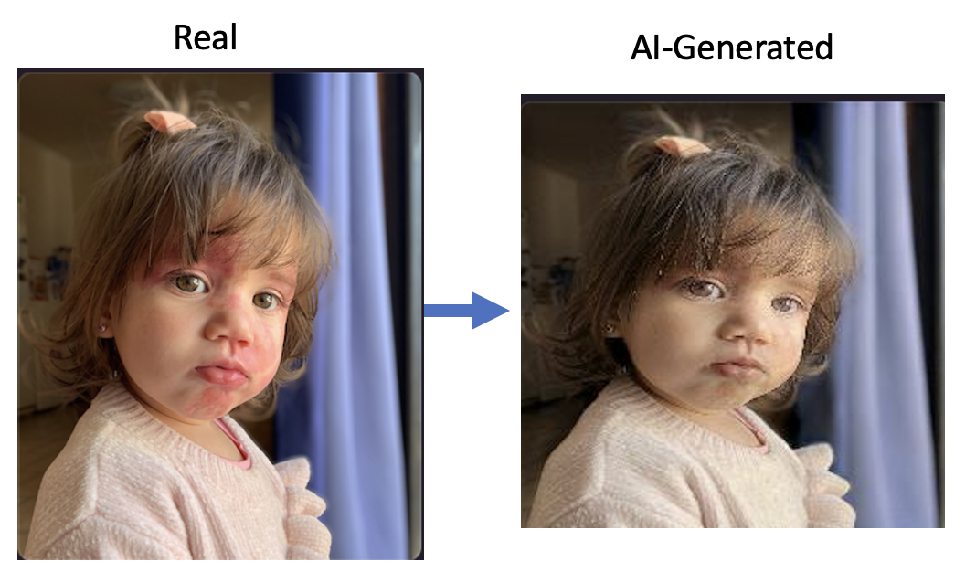
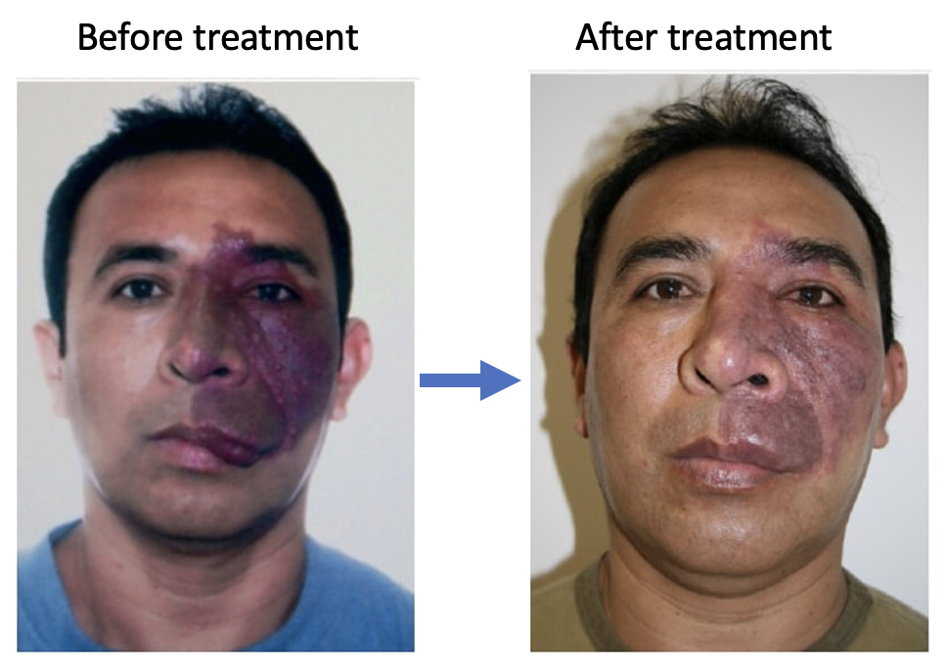
Research Aim
(1) (current) Translate between images of healthy and PWB faces
(2) (future application) Translate between pre and post-treatment images
Notes:
Given these capabilities, CycleGAN seem well-suited for the bidirectionaltransformation between images of healthy facial structures and those exhibiting Port-Wine Birthmarks (PWB)

Slide 4
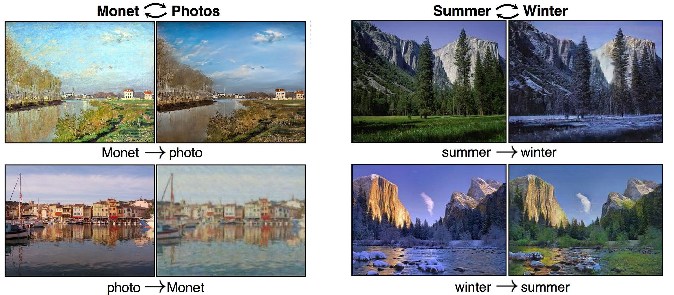
Background
Generative Adversarial Networks (GANs) is a class of Artificial Intelligence
Predominantly, they have been used for Image Generation and Synthesis
A specific variant of GANs, known as CycleGAN, is employed for image translation tasks
Notes:
1. Generative Adversarial Networks (GANs) is a class of Artificial Intelligence
2. Predominantly, they have been used for Image Generation and Synthesis (like synthesis of new human faces) 3. A specific variant of GANs, known as CycleGAN, is employed for image translation tasks. The translation task involves the conversion back and forth between two different image forms. For instance, it can be used for converting between ordinary photographs and monet’s artworks as can be seen on the picture

Slide 5
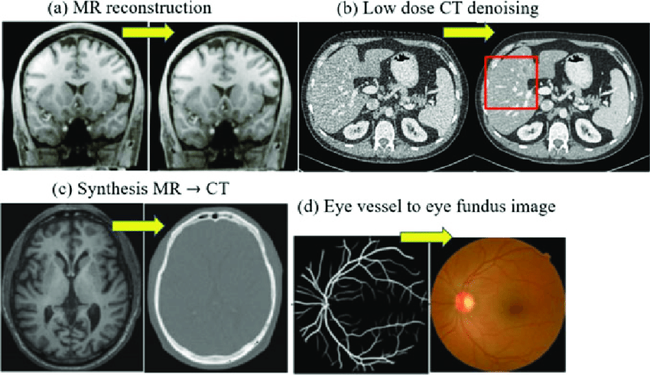
CycleGANs applications in medicine
Notes:
To showcase cycleGAN expressive power, let’s look at its common applications in medicine. CycleGAN has been used for task such as enhancing MR reconstruction, conversion MR to CT images, or translating eye vessel to fundus images, showcase its potential

Slide 6
Study design and methods
Utilized PWB patient’s photos from our clinic as well as photos available on the internet – total of ~300 photos
Utilized readily-available database of 7000 picture of human faces
AI was trained on free-to-use Kaggle GPU
Resource limitations necessitated a parameter cap in AI’s power of 10 million parameters total
Resource limitations necessitated an image resolution cap of 256x256 pixels

Slide 7
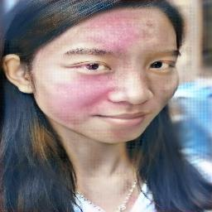
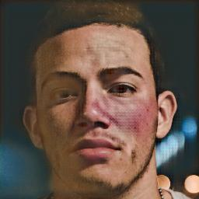
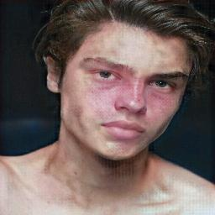
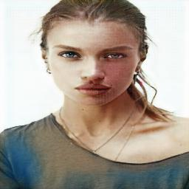
Results – generating PWB faces

Slide 8
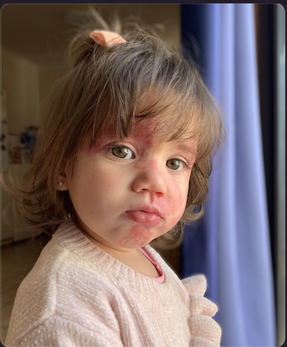
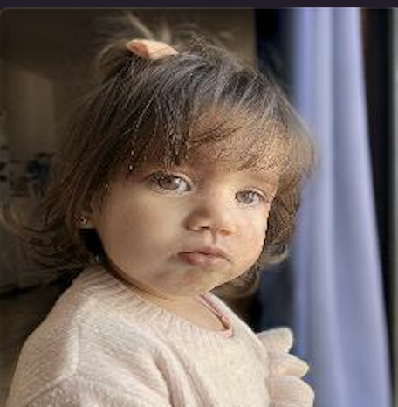
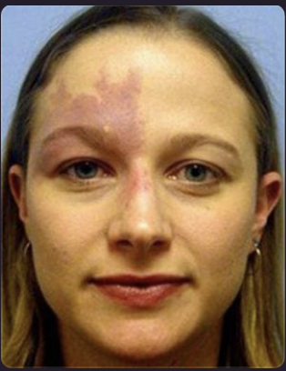
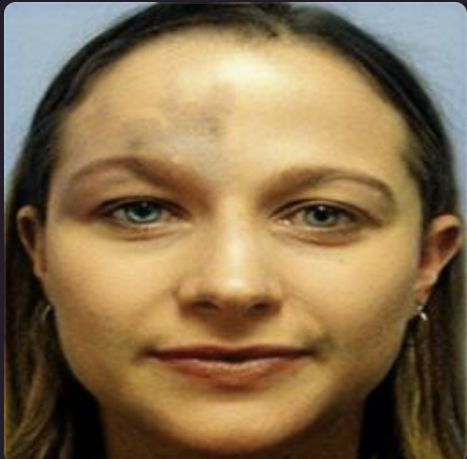
Results – removing PWB from faces
Notes:
As can be seen, even with limited resources that limited the expressive power of AI, cycleGAN was still able to somehow learn how to

Slide 9
Future work
(1) (current) Translate between images of healthy and PWB faces
(2) (future application) Translate between pre and post-treatment images
Main bottleneck – computing power available at our lab
Future – train bigger, more expressive AI that can translate better between images
Main bottleneck – lack of paired data
Future – gather from data across different clinics, and train using a different cGAN (paired data) AI
Notes:
As can be seen, even with limited resources that limited the expressive power of AI, cycleGAN was still able to somehow learn how to

Slide 10

GANs architecture

